Slide 1
Simple Linear Regression

Slide 2
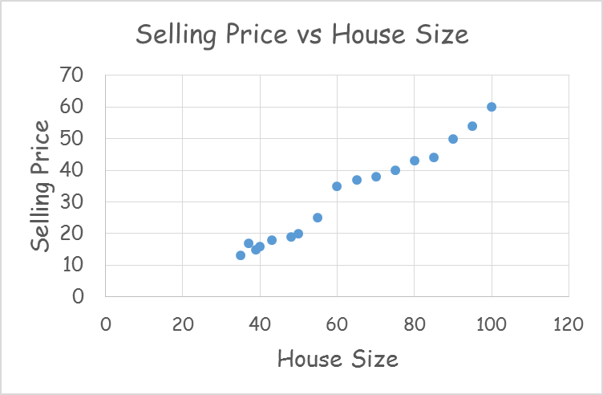
House Price Prediction
Area (SQM) | Selling Price (Lacs)
35 | 13
37 | 17
39 | 15
40 | 16
43 | 18
48 | 19
50 | 20
55 | 25
60 | 35
65 | 37
70 | 38
75 | 40
80 | 43
85 | 44
90 | 50
95 | 54
100 | 60

Slide 3
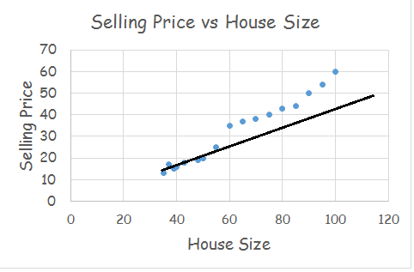
House Price Prediction
Area (SQM) | Selling Price (Lacs)
35 | 13
37 | 17
39 | 15
40 | 16
43 | 18
48 | 19
50 | 20
55 | 25
60 | 35
65 | 37
70 | 38
75 | 40
80 | 43
85 | 44
90 | 50
95 | 54
100 | 60

Slide 4
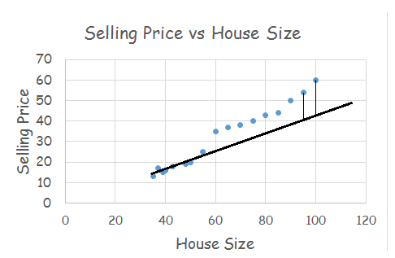
House Price Prediction
Area (SQM) | Selling Price (Lacs)
35 | 13
37 | 17
39 | 15
40 | 16
43 | 18
48 | 19
50 | 20
55 | 25
60 | 35
65 | 37
70 | 38
75 | 40
80 | 43
85 | 44
90 | 50
95 | 54
100 | 60

Slide 5
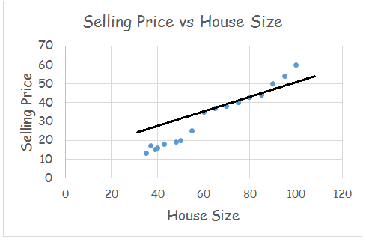
House Price Prediction
Area (SQM) | Selling Price (Lacs)
35 | 13
37 | 17
39 | 15
40 | 16
43 | 18
48 | 19
50 | 20
55 | 25
60 | 35
65 | 37
70 | 38
75 | 40
80 | 43
85 | 44
90 | 50
95 | 54
100 | 60

Slide 6
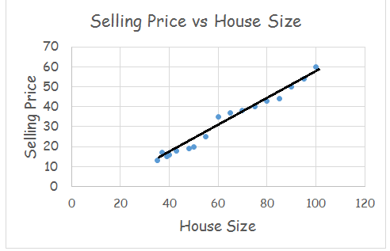
House Price Prediction
Area (SQM) | Selling Price (Lacs)
35 | 13
37 | 17
39 | 15
40 | 16
43 | 18
48 | 19
50 | 20
55 | 25
60 | 35
65 | 37
70 | 38
75 | 40
80 | 43
85 | 44
90 | 50
95 | 54
100 | 60

Slide 7
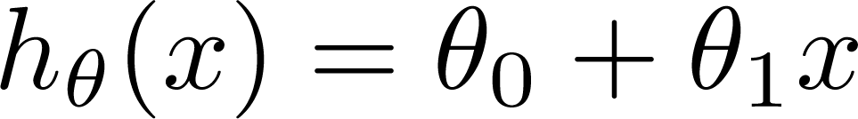
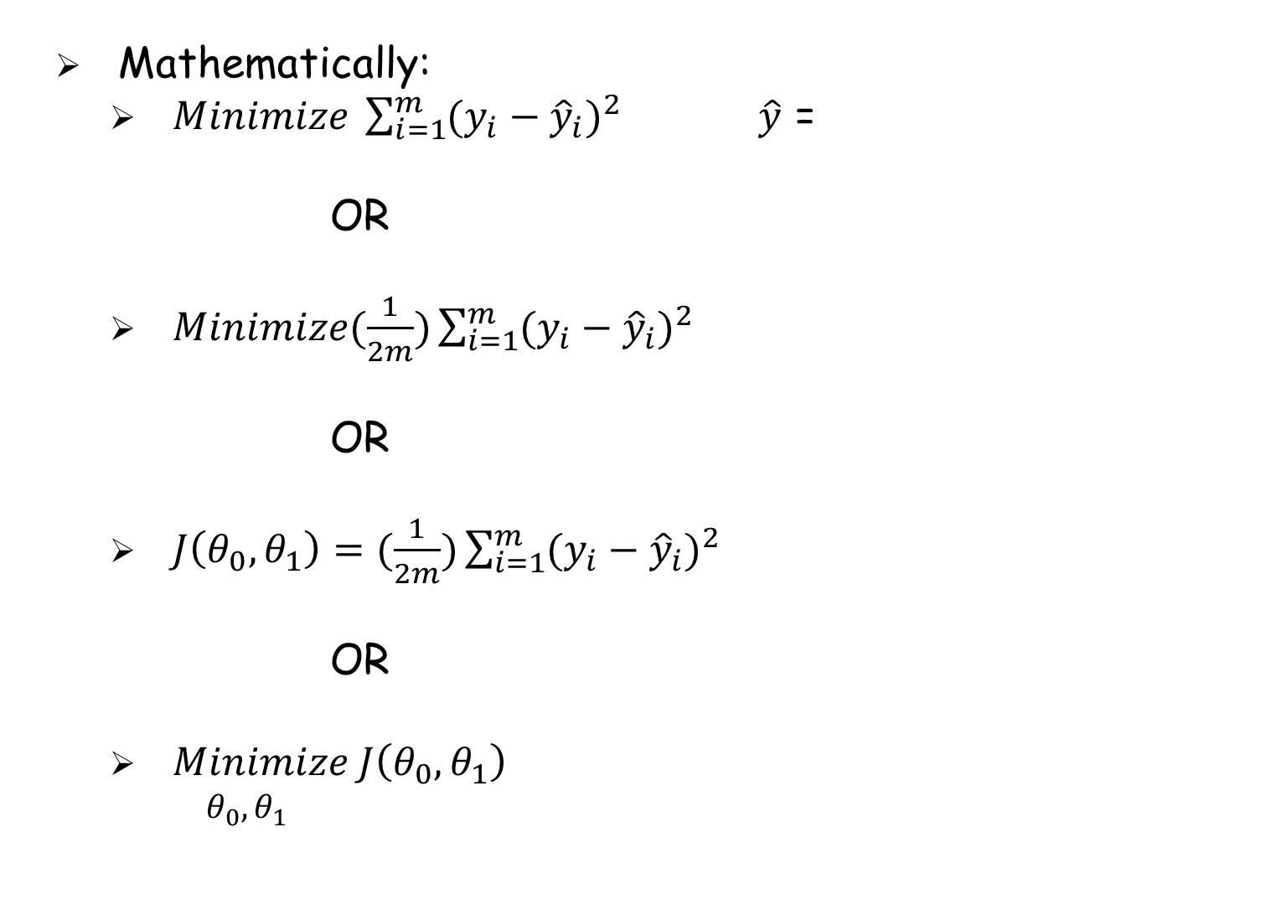
House Price Prediction
Mathematically:
$Minimize \sum_{i=1}^{m}{{(y_{i}−{\hat{y}}_{i})}^{2}}$ $\hat{y}$ =
OR
$Minimize(\frac{1}{2m})\sum_{i=1}^{m}{{(y_{i}−{\hat{y}}_{i})}^{2}}$
OR
$J\left(θ_{0},θ_{1}\right)=(\frac{1}{2m})\sum_{i=1}^{m}{{(y_{i}−{\hat{y}}_{i})}^{2}}$
OR
$Minimize J\left(θ_{0},θ_{1}\right)$
$θ_{0},θ_{1}$

Slide 8
X | y | Ŷ (θ=0) | Ŷ (θ=1) | Ŷ (θ=2 | Ŷ (θ=3
1 | 2 | 0 | 1 | 2 | 3
2 | 5 | 0 | 2 | 4 | 6
3 | 5 | 0 | 3 | 6 | 9
5 | 11 | 0 | 5 | 10 | 15
6 | 11 | 0 | 6 | 12 | 18

Slide 10



House Price Prediction
Mathematically:
$$J\left(θ_{1}\right)$$
at local optima
Current value of

Slide 11
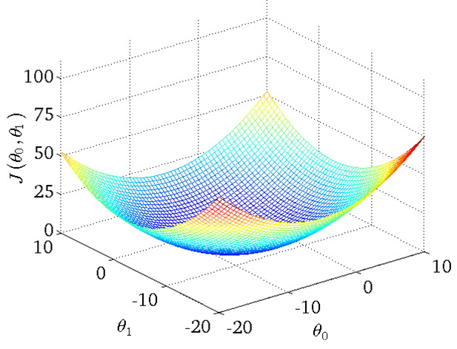
House Price Prediction
Mathematically:

Slide 12
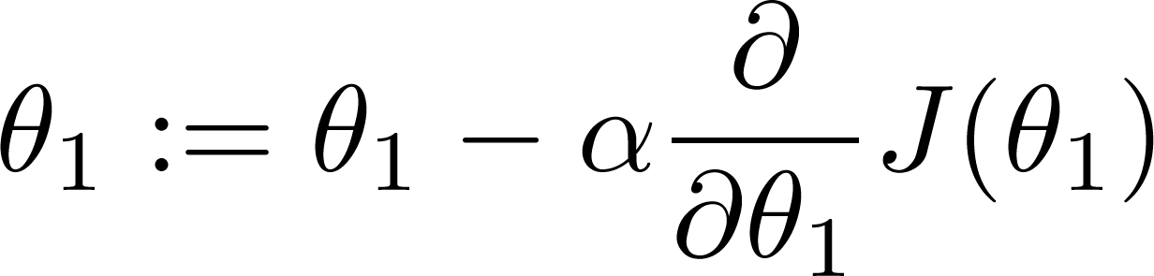
If α is too small, gradient descent can be slow.
If α is too large, gradient descent can overshoot the minimum. It may fail to converge, or even diverge.

Slide 13
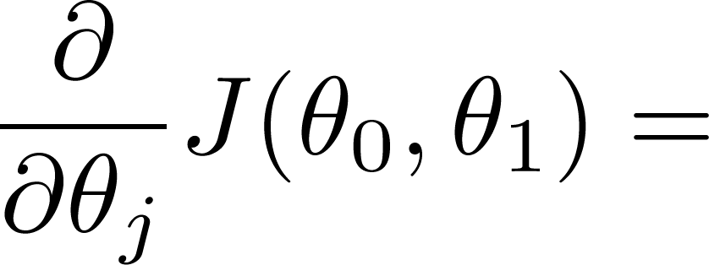
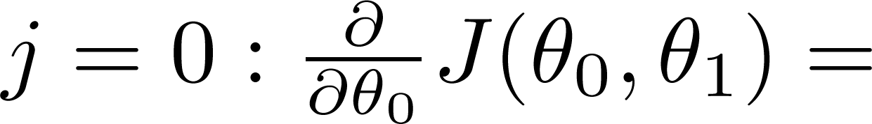
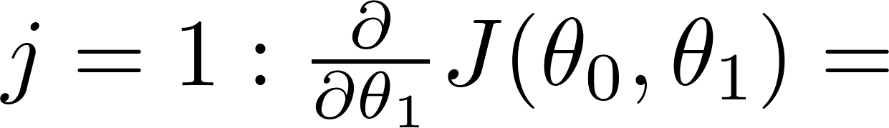
House Price Prediction
Gradient Descent Algorithm

Slide 15
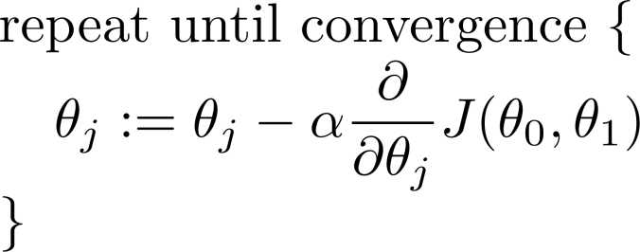
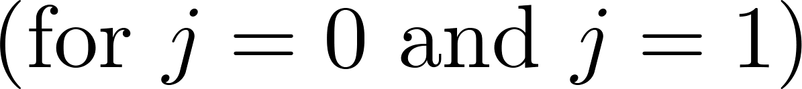
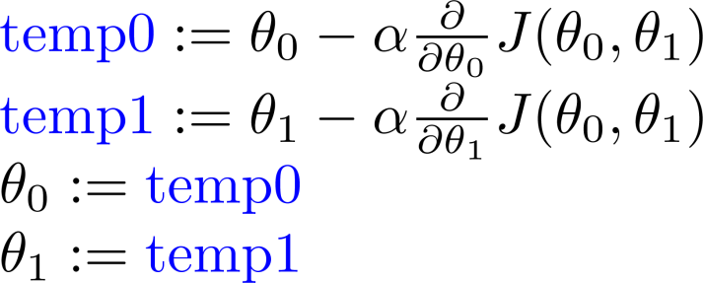
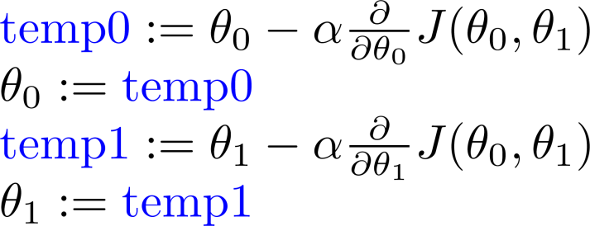


House Price Prediction
Gradient Descent Algorithm
Correct: Simultaneous update
Incorrect:
=

Slide 16
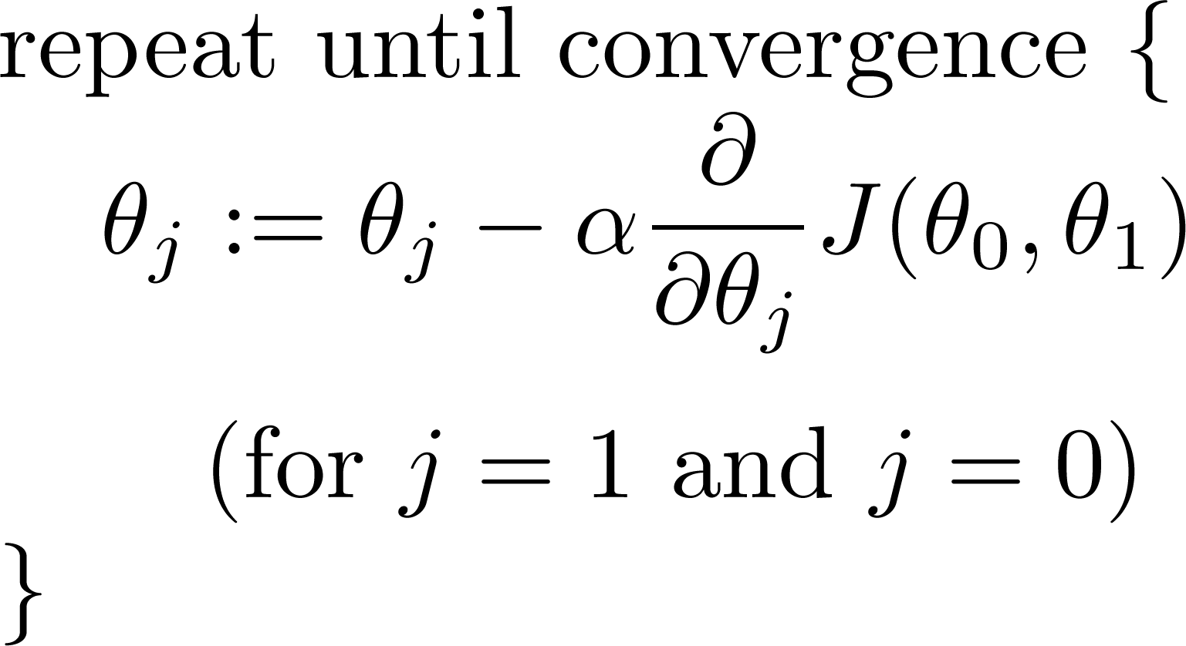
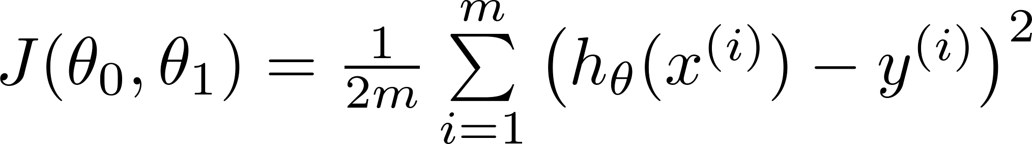
House Price Prediction
Gradient Descent Algorithm
Gradient descent algorithm
Linear Regression Model

Slide 17
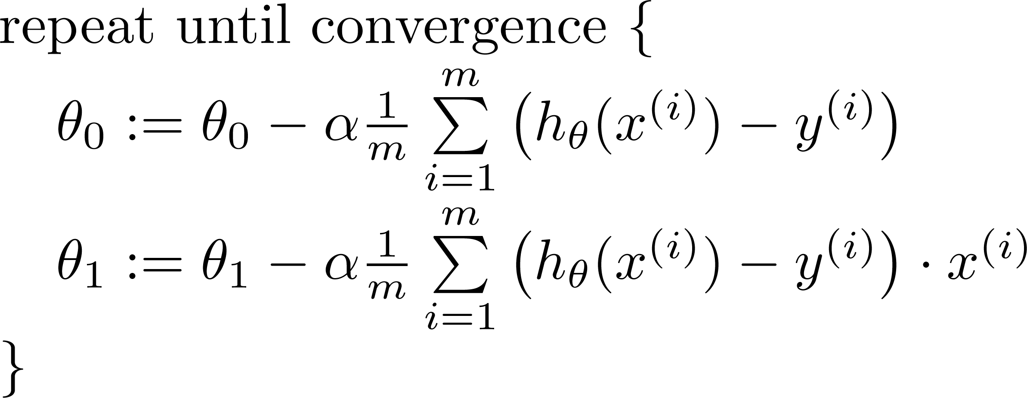


House Price Prediction
Gradient Descent Algorithm
Area (SQM) | Selling Price (Lacs)
35 | 13
37 | 17
39 | 15
40 | 16
43 | 18
48 | 19
50 | 20
55 | 25
60 | 35
65 | 37
70 | 38
75 | 40
80 | 43
85 | 44
90 | 50
95 | 54
100 | 60
update
and
simultaneously
=
If $θ_{0}$ = 1 and $θ_{1}$ = 0.5 ?

Slide 19
“Batch” Gradient Descent
“Batch”: Each step of gradient descent uses all the training examples.

Slide 20
References
Andrew Ng’s slides on Linear Regression from his Machine Learning Course on Coursera.

Slide 21
Disclaimer
Content of this presentation is not original and it has been prepared from various sources for teaching purpose.

Slide 22
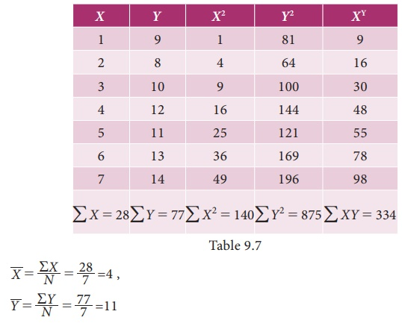
Solve the regression problem and calculate the coeffiient

Slide 23

